Slide 1
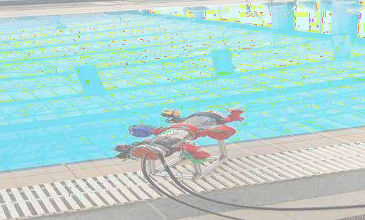
SUBMERGED REMOTE CONTROL VEHICLE
TEAM RED
SANKET DAYAL (23120006), VISITING STUDENT LDCE, MECHANICAL ENGINEERING
SHREYASH AGRAWAL(20110196), IITGN, MATERIAL ENGINEERING

Slide 2

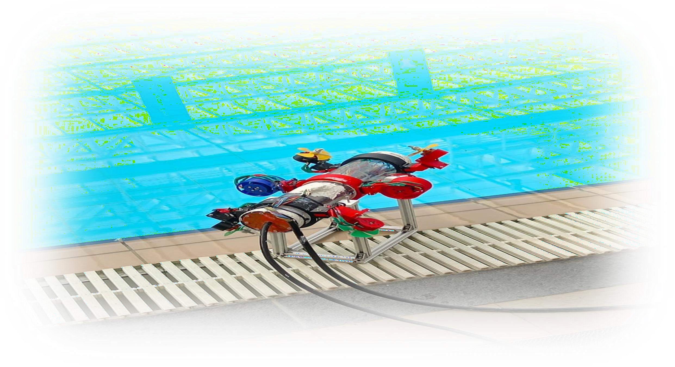

Slide 3
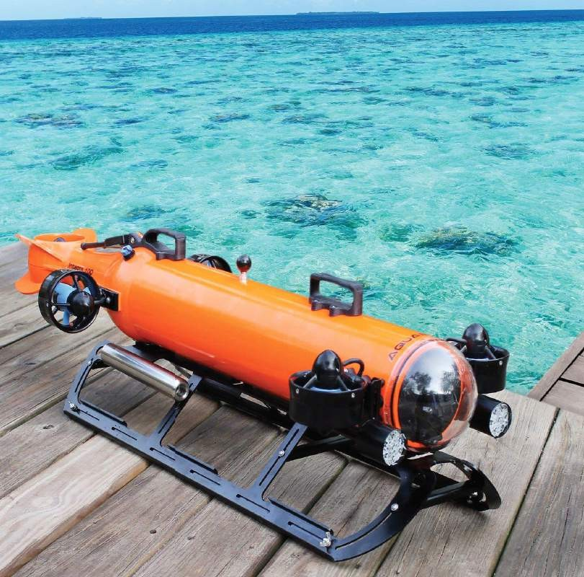
INTRODUCTION
Remotely Operated Vehicles (ROVs) are advanced robotic machines used for exploring and working in the depths of our oceans
Underwater vehicle plays crucial role in,
Ocean exploration
Marine Science and Research
Oil and Gas Industry
Infrastructure Inspection

Slide 4
OBJECTIVE
SRCV should go below the water surface minimum at 6 feet from water surface.
SRCV should travel completely underwater and can handle water pressure and moves against it

Slide 5
THRUSTER CONFIGURATION:
THRUSTER- 6
THRUSTER- 5
THRUSTER 4
THRUSTER 3
THRUSTER- 2
THRUSTER- 1

Slide 6
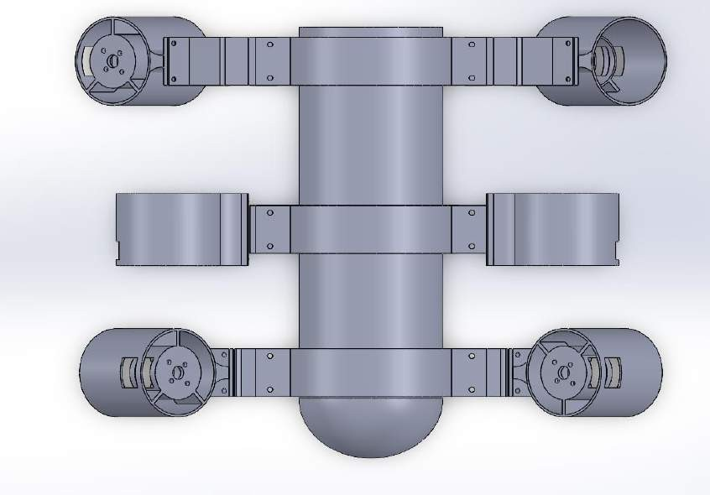
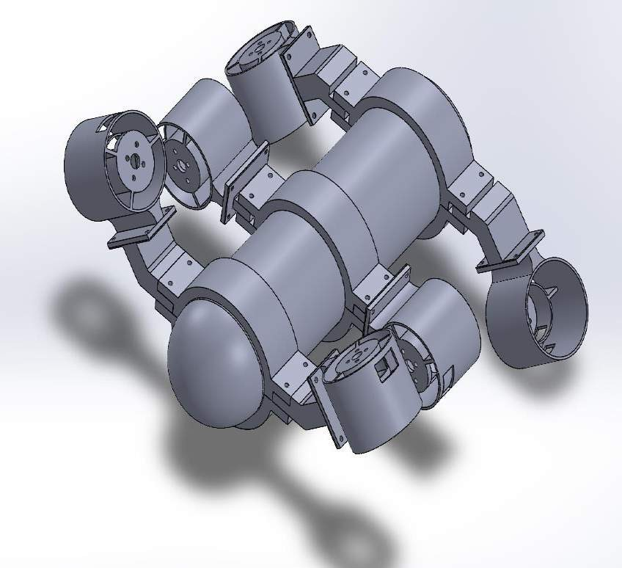
THRUSTER CONFIGURATION
SIX THRUSTER CONFIGURATION

Slide 7
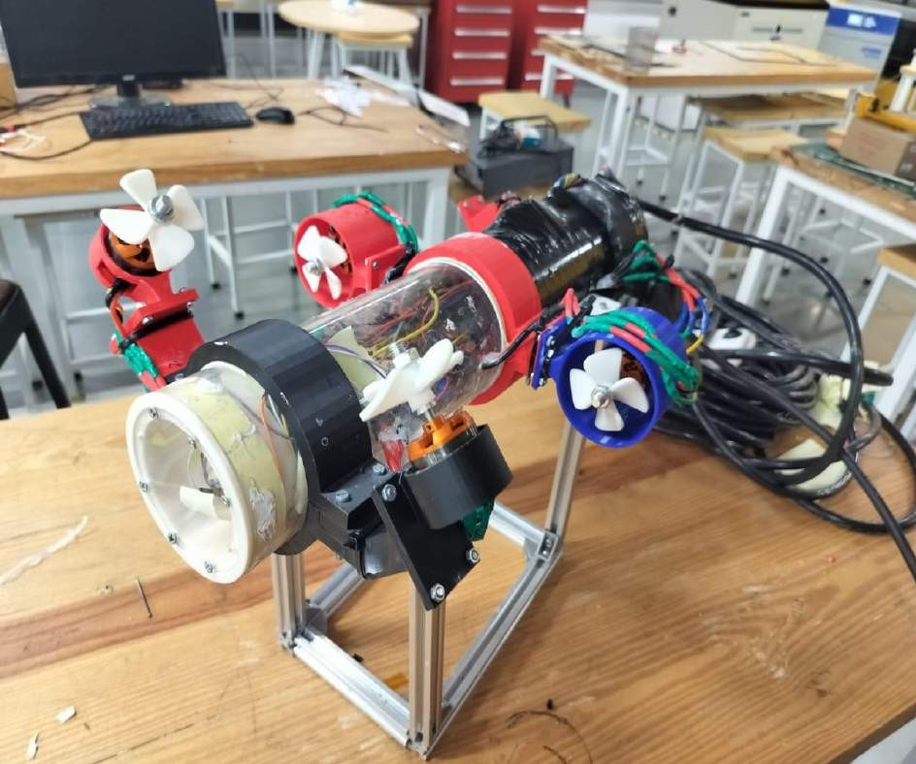
DESIGN AND COMPONENTS

Slide 8
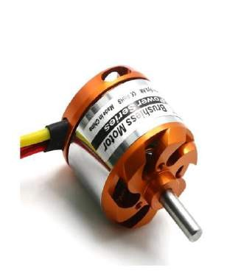
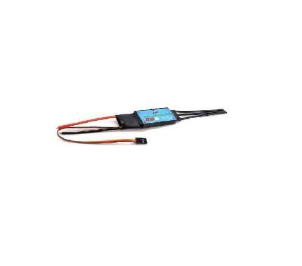
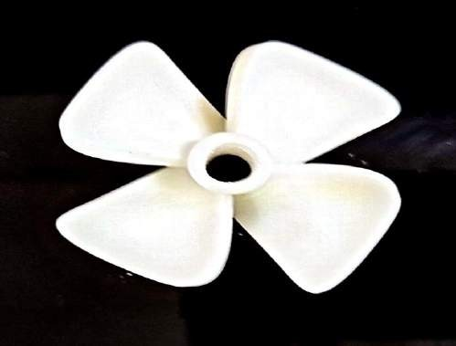
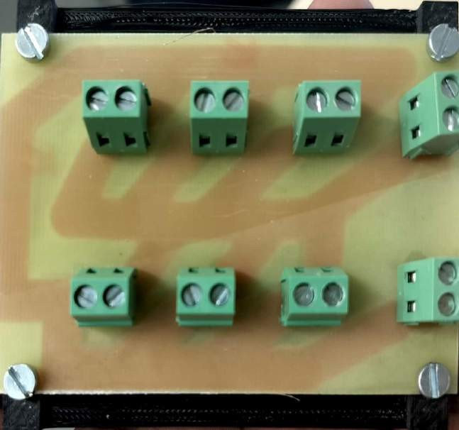
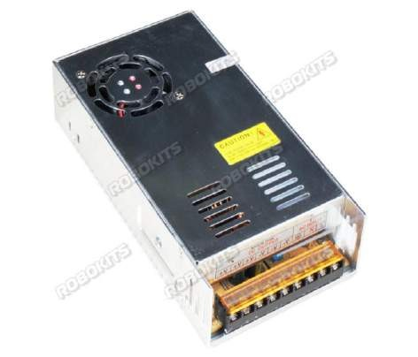
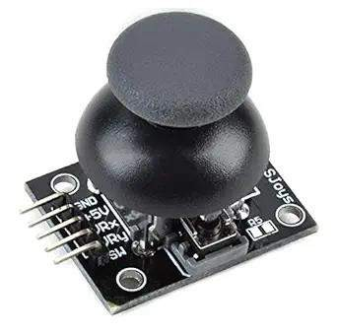
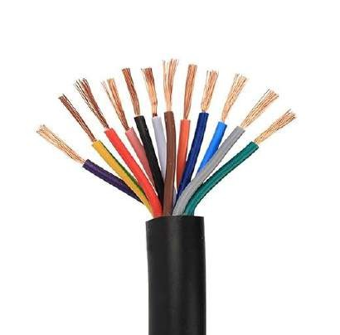

BLDC MOTOR
BIDIRECTIONAL UBEC ESC
PROPELLER
PRINTED CIRCUIT BORD
SMPS
JOYSTICK
SIGNAL WIRE
ACRYLIC CYLINDER

Slide 9
POWER DISTRIBUTION:
220V,6AMP
AC-DC
220v(AC)-12V, 50AMP(DC)
SIGNAL WIRE
JOYSTICKS
Surface side
THETHER
SRCV side
12V 50AMP
BLDC+ESC
PWM
BLDC+ESC
PWM
BLDC+ESC
PWM
ARDIN UNO+BRADBORD+PRINTED CIRCUIT BORD(PCB)
BLDC+ESC
PWM
BLDC+ESC
PWM
BLDC+ESC
PWM

Slide 10
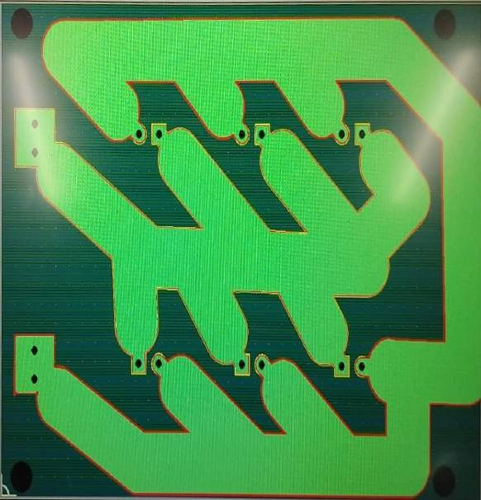
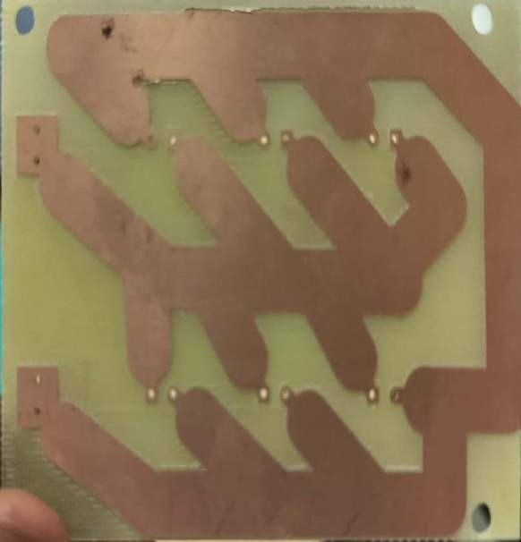
PCB DESIGN

Slide 11
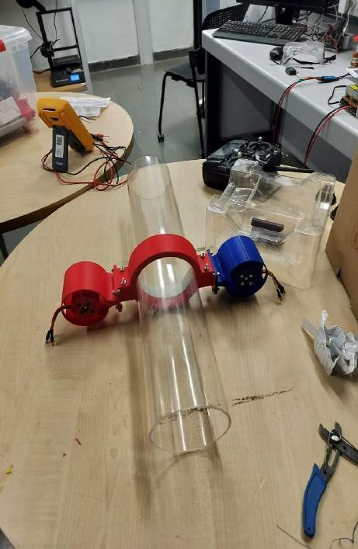
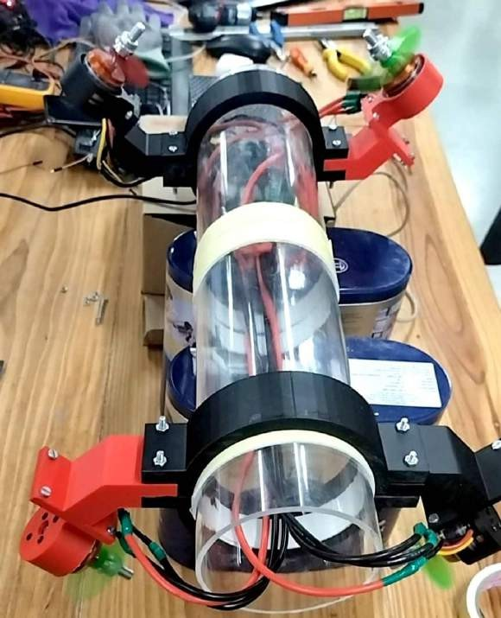
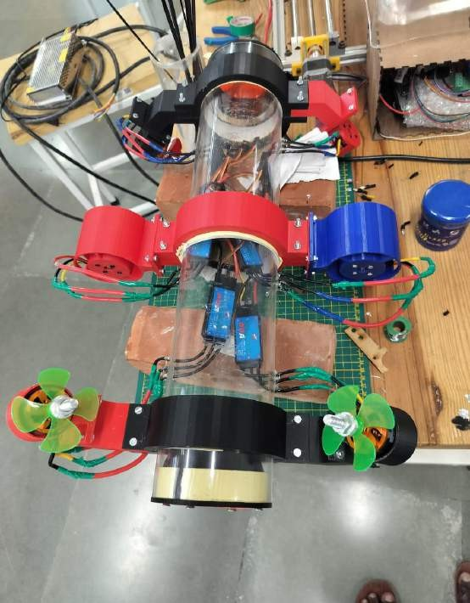
ACTUAL DESIGN
STEP-1
STEP-2
STEP-3

Slide 12
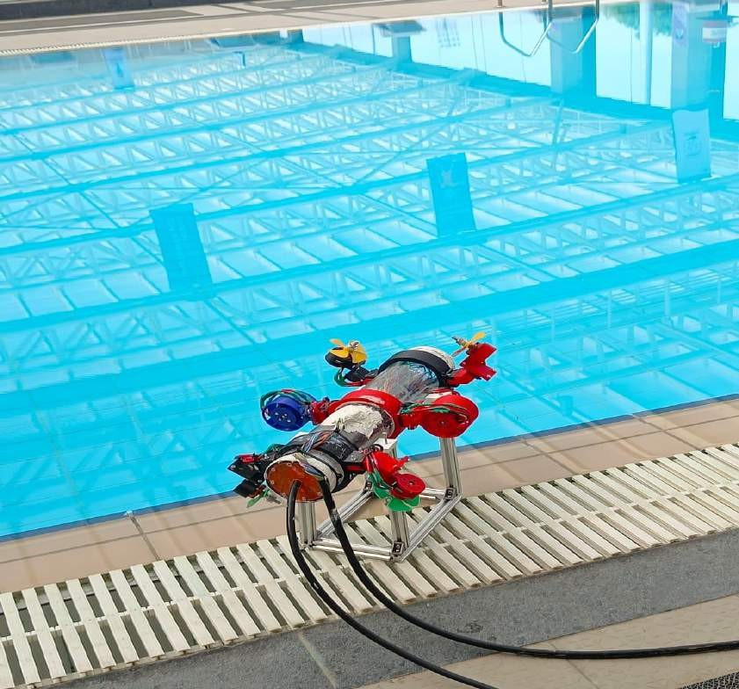
STEP-4
STEP-5

Slide 13
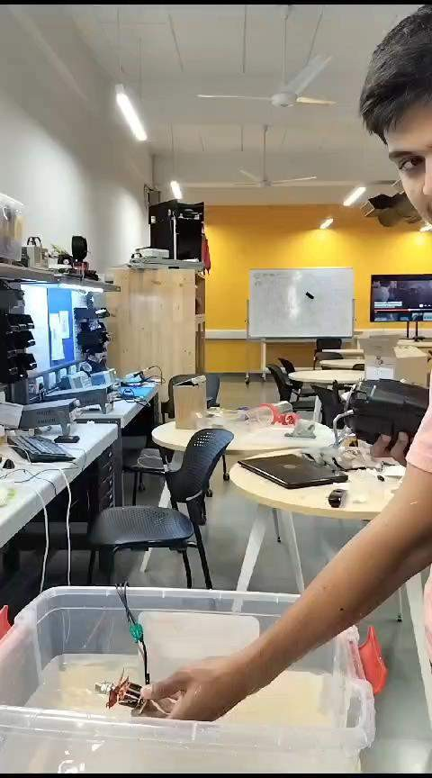
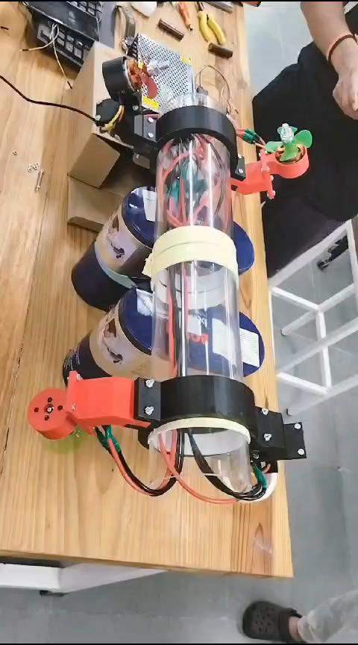

Slide 14
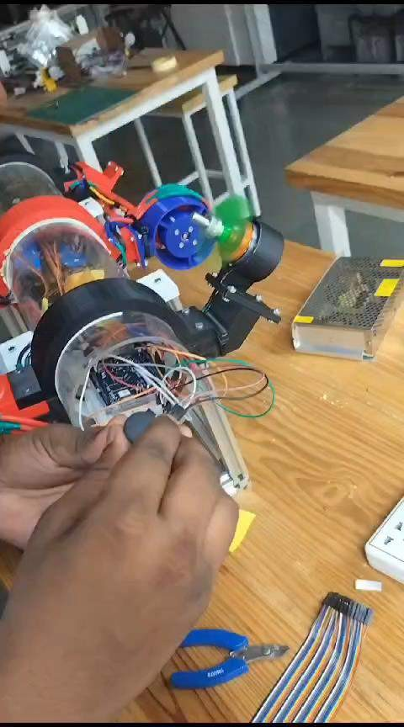
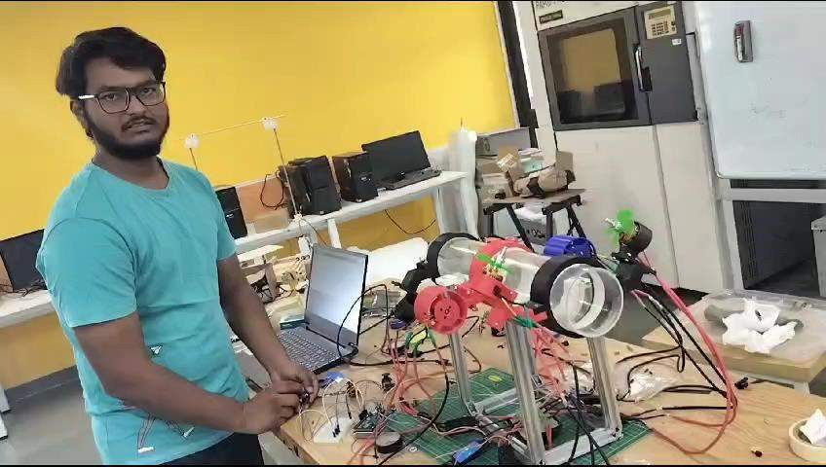

Slide 15
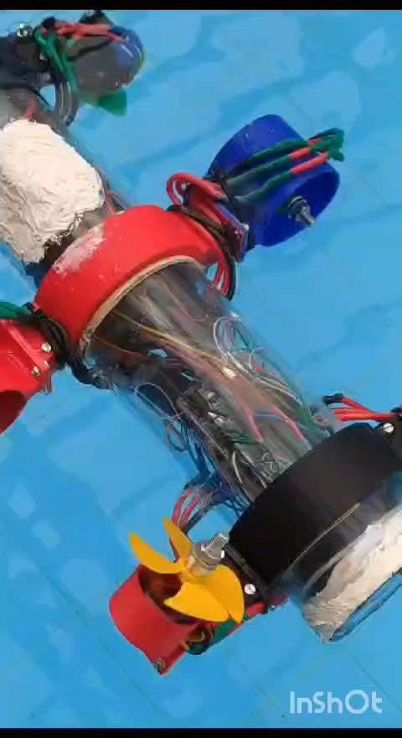
WORKING MODEL

Slide 16
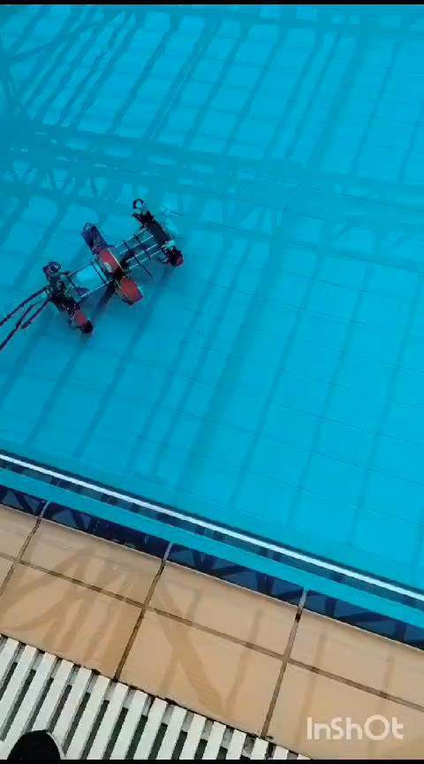

Slide 17
PROBLEM FACED
The vehicle is not going inside the water.(solved)
The power supply was not sufficient.(solved)
After that the propeller are breaking in the water.(solved)
The bldc motor is not working continuously inside the water.
After assembling we get to know that two ESC and one bldc is not working.(solved)
Assembling (solved)

Slide 18
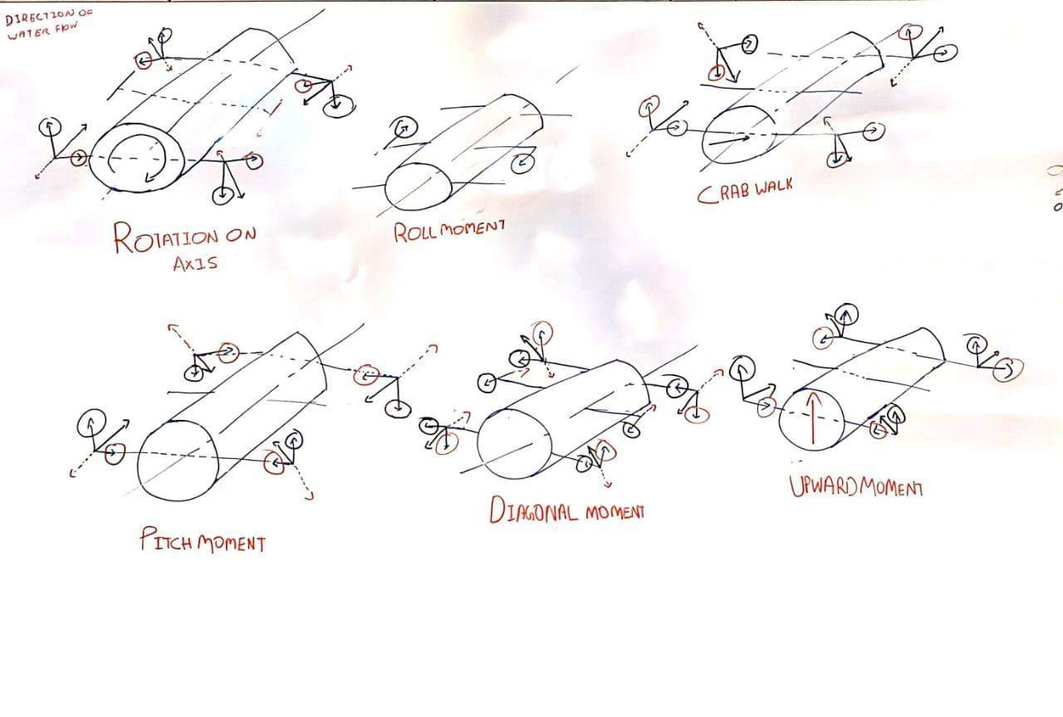
VECTOR ANALYSIS OF THRUSTERS

Slide 19
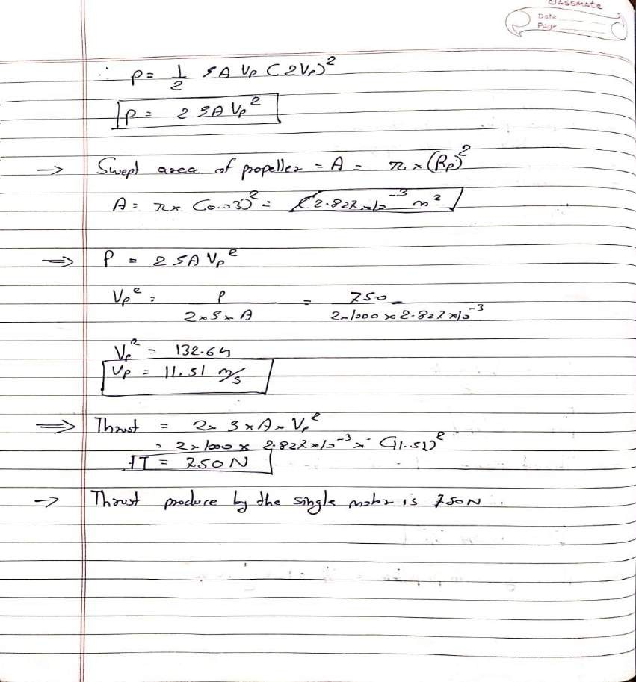
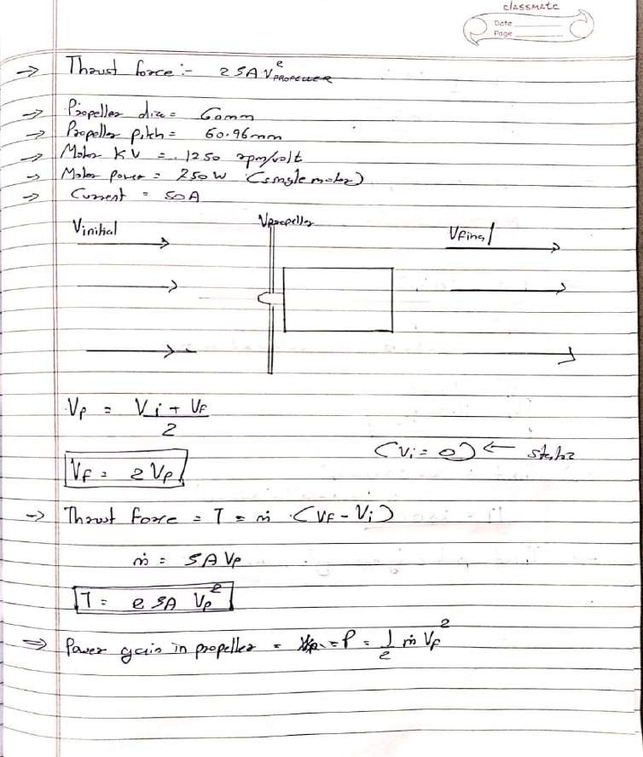
CALCULATIONS

Slide 20
THANK YOU

